Slide 1



Business Performance
Review of PRISM
Cubic Consulting
Expertly navigating the data maze for you
Notes:
A business assessment conducted for Prism’s functional areas of Customer, Marketing Web & Product. With analysis of the KPI’s & KRI’s, and recommendations for each area.

Slide 2
EXECUTIVE SUMMARY
Customer:- Churn rate decreased ‘20-’21 but increased in ‘22 at 14% - 16%
Marketing:- Opt-in customers spent lower than non-opt-ins due to coupon usage
Product:- Return rate from 26% - 29% between ‘20 and ‘22 against industry average 20%
Web:- 0.9% Conversion Rate, compared to industry average of 2.6%.

Slide 3
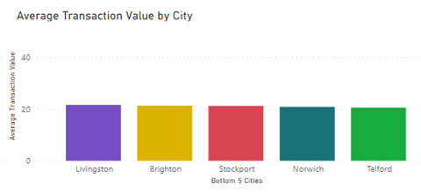
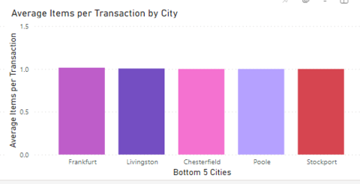
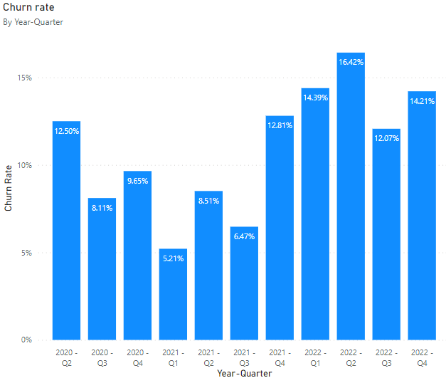
Customer
Recommendations:-
Provide free shipping for orders over £50 to increase transaction value.
Provide 10% discount with multi-buy to increase order numbers.
Reduce churn rate with customer satisfaction surveys for further insight.
Notes:
Analysis:-
Average Transaction Value ranges from £20 - £46
Average order numbers are only around 1
Churn rate decreased ‘20-’21 but increased in ‘22 at 14% - 16%

Slide 4
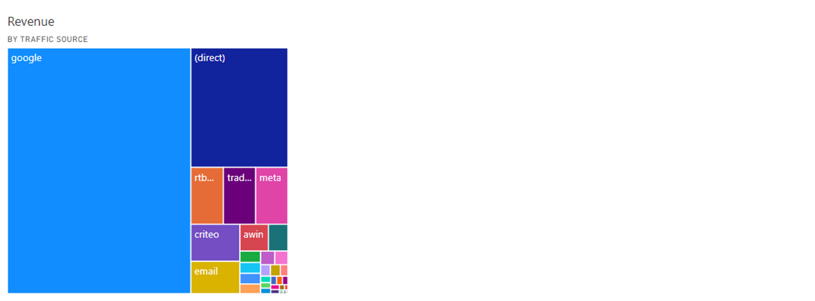
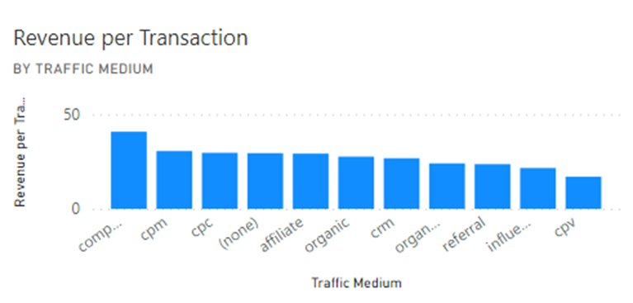
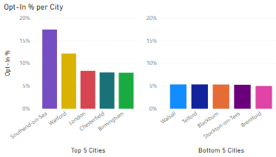
Marketing
Recommendations:-
Focus on SEO for Organic Search & high income generating marketing channel - Google (£10.2k) and on high income generating traffic mediums - Comparison & CPM (£54 & £48 per trans’ )
Discontinue investment in low income revenue channels - TikTok, Youtube & Twitter, and low income traffic mediums - Influencer & Referral
10% sign up offers with email to encourage opt-ins as proven positive coupon activity
Notes:
Analysis:-
Revenue from marketing channels with overall lowest from TikTok, Youtube & Twitter between £85 - £150 over the 3 years
Revenue per transaction at similar levels and of growth for desktop, mobile & tablet from £25 to £38, 2020-2022
3 of the lowest transaction revenue from traffic mediums - Influencer, Referral.
Opt-ins 5% - 17% across the country, more info needed - Open & Click rate
Recommendations:-
Not to continue investing in low income revenue channels, continue focus on high income generating ones - Google (£10.2k), Direct (£2.7k)
Eliminate traffic mediums which contribute low income, focus on high income generating ones - Comparison & CPM (£54 & £48 per trans’ )
Provider special email offers to encourage opt-ins and increase customer engagement
Increase mobile app engagement with user friendliness & personalization

Slide 5
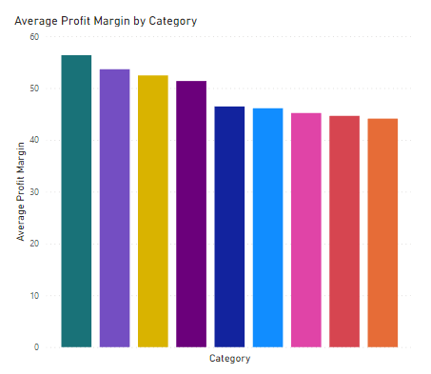
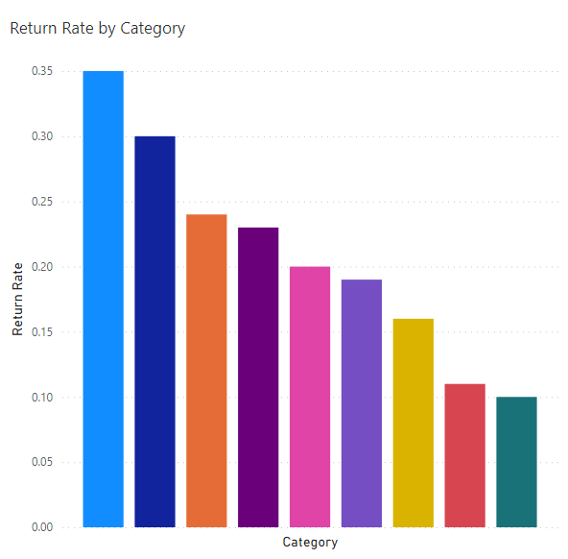
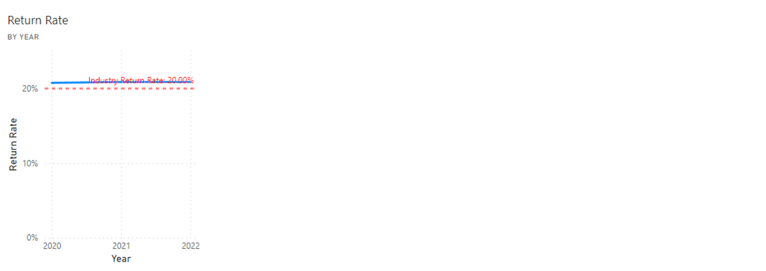
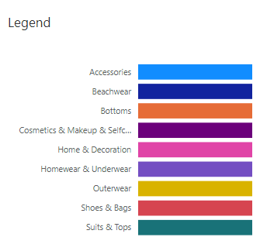
Product
Recommendations:-
Customer feedback survey to see how best to overcome returns
Provide store credit in exchange for returns
Take customer identification to combat serial returners
Quality control & provide clearer product information online
Notes:
Analysis:-
Lowest profitability from beachwear due to seasonality, but shoes & bags overall lowest
Return rate from 26% - 29% between 2020 and 2022 - Industry average 20%
Most returns are from shoes & bags over the 3 years with up to 36% return rate
Recommendations:-
Find out reason for returns by carrying out customer feedback survey to see how best to overcome these returns
Provide store credit in exchange to ensure customers still spend with us
Take customer identification to combat serial returners
Provide clearer product information online
Invest in quality control and improvement for all products with return rates above industry average.

Slide 6
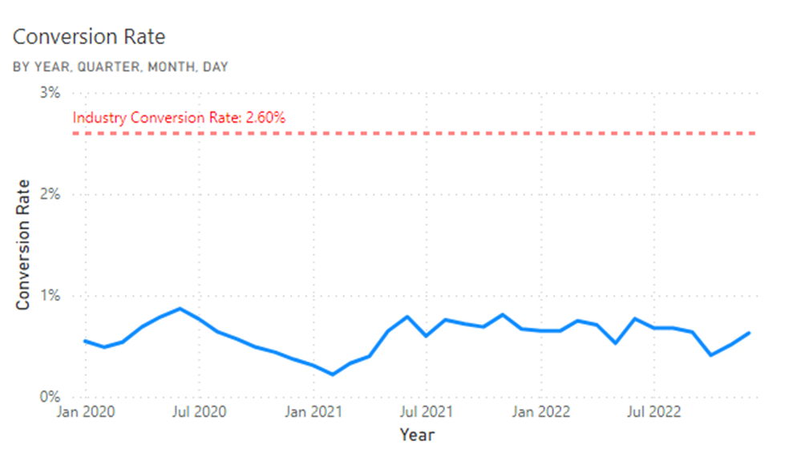
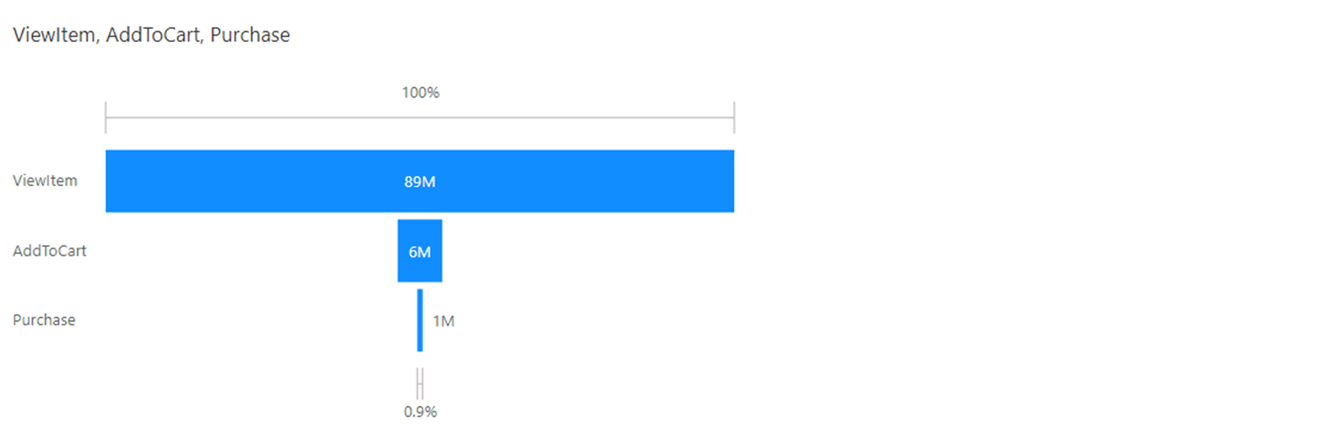
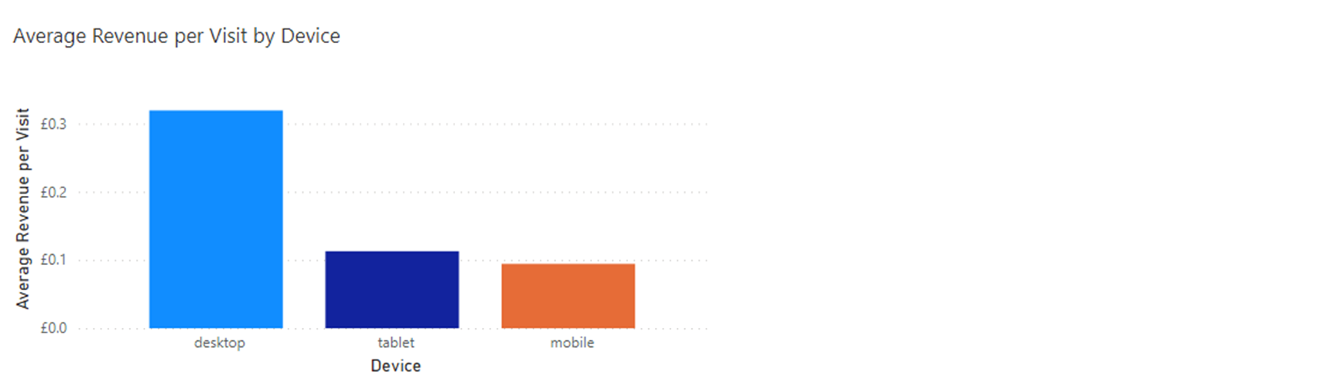
Web
Recommendations:-
Use A/B testing or a multivariate testing software - Google Optimize, to test the optimal purchase to pay process - call to action, page layout, product description
Email personalisation to target and bring back customers who visited but left without proceeding through the website.
Implement mobile app to increase Revenue per Visit by mobiles
Notes:
0.9% Conversion Rate, compared to industry average of 2.6%. https://www.heap.io/topics/ecommerce-conversion-funnel-optimization-guide
7.5% conversion from View Item to Add to Cart compared to 16.7% conversion from Add to Cart to Purchase.
Use effective CTAs, clock countdowns, and personalised messages in A/B testing to drive up the funnel conversion rate from View Item to Add to Cart.
82-95% of customers will come back if marketing is done in a timely and effective manner and will also recommend Prism to 5 potential customers on average.
https://databox.com/improve-your-funnel-conversion-rateImplement mobile app to increase Revenue per Visit by mobiles
Implement mobile app to increase revenue per Visit by mobiles- Ever-increasing use of smartphones and an increasingly common sight in every industry.

Slide 7
We would have also liked to look at…
Customer:- Demographics, seasonality and trends to benchmark against
Marketing:- Open & click through rates to assess opt-in success
Product:- Detailed product information such as sizes
Web:- To go through the website and checkout process ourselves
Assumption:-
Guest customers not accounted for as we cannot track customer history
Limitation:-
Lack of data for marketing costs - unable to assess budgets and total net profit
Notes:
Web - To go through the website and checkout process ourselves to ensure user friendliness, speed and simplified browse to checkout process

Slide 8

Questions & Feedback welcome
Our workings:-
https://rb.gy/tsh0l
https://rb.gy/y6yw3
Our dashboard:-
https://rb.gy/qbs4s

